Slide 1
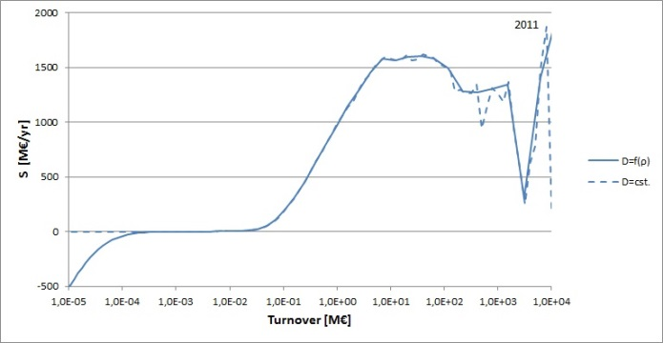
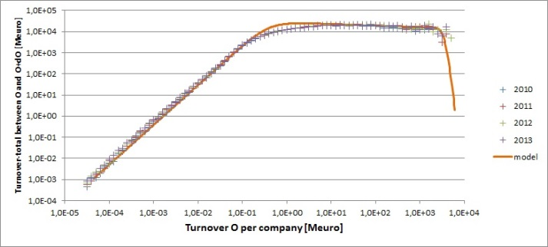
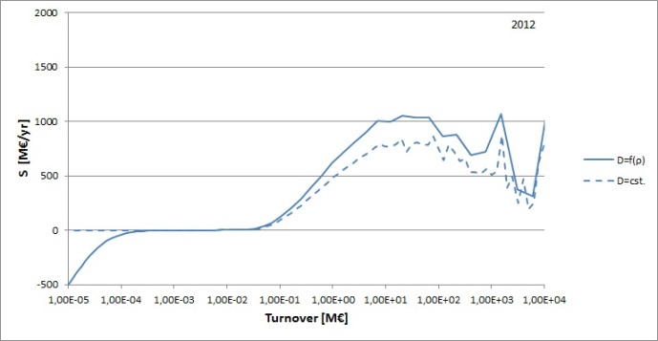
Complexity applications in official statistics
Your photo
Here
Dr Frank P. Pijpers (CBS/Statistics Netherlands)
Contact Details: f.pijpers@cbs. nl
abstract
methods
results
The aim of complexity studies within the framework of national statistical institutes such as Statistics Netherlands is among others to be able to indicate correctly which sectors of business activity are vulnerable/ fragile and also which are most robust.
A current research project explores some toy models from dynamic system theory to investigate the behaviour of trade and turnover of businesses in the Netherlands, using register data to which Statistics Netherlands as national statistical institute has access.
This approach leads to an differential equation that describes the distribution function ψ for company turnover ρ which looks like a diffusion equation:
With a chosen D and a measured ψ it is possible to check which external/market conditions (source function) S lead to that form for ψ. Alternatively one can choose a simple parameterised form for S and solve the differential equation, adjusting parameters to attempt to fit the data.
Choosing D and solving for α and S leads, for the years 2011 and 2012, to the figure above and below.
Clearly at annual turnovers of around 50-100k€ the
inferred source function S rises steeply.
background
The goal in the first instance is to show which steps are needed in building a viable analysis tool:
Every company is seen as an agent with as its only characteristic property the turnover. Companies can therefore only differ from one another in the size of their turnover, and the most important outcome of the model is the distribution function ψ of the turnover for the business population. This is a genuinely measurable quantity.
Every interaction between companies changes the turnover by small amounts relative to the annual total, and takes place preferentially between agents with similar turnovers i.e. that do not differ by many orders of magnitude
Fig. 1 The measured ψ for four consecutive years (crosses), and a very simple source function model.
conclusions
The overall growth α gives a representative, ie. well-weighted, value of turnover growth for the entire population of companies which is a key indicator for the state of the Dutch economy.
The further analysis of the source function can be used to assess, even per business sector, at which size of companies a stimulus package or support measures are most desirable in times of economic 'heavy weather'.

